Slide 1
PLT: Week 4
Chomsky and his work on natural languages

Slide 2
To Summarize, to date
Appreciation of structuring of (complex) maths expressions;
Proofs: generating new truths/language instances;
Adapted to schema, to generate strings-with-properties language instances:
  Post Production Systems;
And schema to generate general (maths) language instances:
  Valid expressions;
In doing so, we have seen how rules can be used in generation of language instances;

Slide 3
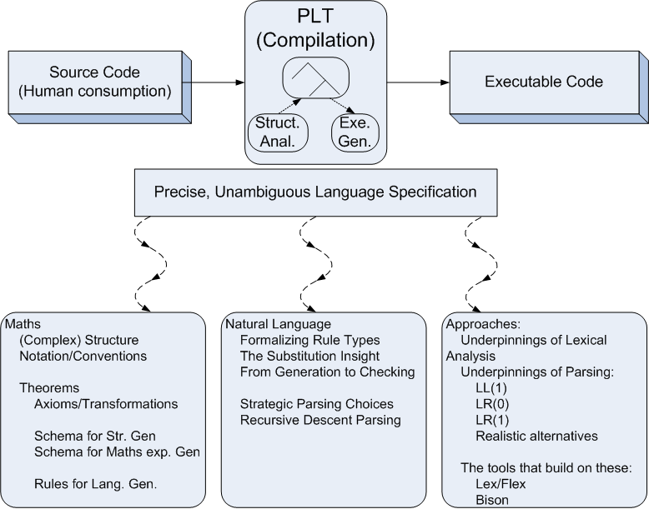

Module Overview

Slide 4
Chomsky’s First Two Contributions
He focused on the study of languages, rather than Maths
  At above word level, rather than strings
He realised that (abstraction-based) substitution could be used instead of Post’s extension/transformation:
  English structures could be generated by populating a template of categories:
    Phrase:
      The brown cat, A lazy dog
      What are the abstractions?

Slide 5
Phrase Structure (in production-rule format)
Instances:
    The big rat
    A helpful frog
    Some brown cat
Productions
    A->some, A->a, A->the
    D->big, D->brown, D->helpful
    N->cat, N->rat, N->frog
    P->ADN
    Where {some, a the, big, brown, helpful, cat, rat, frog} are the Literals
    And {A, D, N, P} are the Variables
Notes:
<νυμβερ>
How can we accommodate all the above instances
Here are the production rules – variables and literals obvious. Most of the production rules already there, just a new one to take care of sentences being noun-phrase, verb, noun-phrase
I do one, they do 2 and 3. Use the overbrace, with LHS on top notation

Slide 6
Try: How do we cope with 1 or more adjectives
    For example:
      The big brown rat
      The big brown helpful cat
    This is vitally important:
      Covers lots of cases in programming languages;
    And how do you cope with 0, 1 or more

Slide 7
How do we cope with 1 or more adjectives
    For example:
      The big brown rat
      The big brown helpful cat
Productions
    A->some, A->a, A->the
    D->big, D->brown, D->helpful
    N->cat, N->rat, N->frog
    P->AQN
    Q->D
    Q->DQ

Slide 8
How do we cope with 0, 1 or more adjectives
    For example:
      A frog
      The big brown rat
      The big brown helpful cat
Productions
    A->some, A->a, A->the
    D->big, D->brown, D->helpful
    N->cat, N->rat, N->frog
    P->AN
    P->AQN
    Q->D
    Q->DQ
Notes:
Q-> D is now redundant, making the grammar ambiguous:
Q->DQ where Q goes to lamba, would have the same effect: therefore 2 parse trees, therefore ambiguity
<νυμβερ>

Slide 9
Try: An Overall Sentence Structure
Instances:
    The cat chased the big rat
    The big dog hit the black helpful frog
    A frog caught a big black helpful cat
Notes:
<νυμβερ>
How can we accommodate all the above instances
Here are the production rules – variables and literals obvious. Most of the production rules already there, just a new one to take care of sentences being noun-phrase, verb, noun-phrase
I do one, they do 2 and 3. Use the overbrace, with LHS on top notation

Slide 10
Overall Sentence Structure
Instances:
    The cat chased the big rat
    The big dog hit the big helpful frog
    A frog caught a big black helpful cat
Productions
    A->some, A->a, A->the
    D->big, D->black, D->helpful
    N->cat, N->rat, N->dog, N->frog
    V-> hit, V->chased, V->caught
    S-> PVP
    P->AN
    P->AQN
    Q->D
    Q->DQ
Notes:
<νυμβερ>
How can we accommodate all the above instances
Here are the production rules – variables and literals obvious. Most of the production rules already there, just a new one to take care of sentences being noun-phrase, verb, noun-phrase
I do one, they do 2 and 3. Use the overbrace, with LHS on top notation

Slide 11
Next Contribution: new terminology (Phase Structure, Generative Grammars)
4-tuple {V_{T}, V_{N}, P, S}:
  V_{T}
  V_{N}
  V_{N} U V_{T} = {V}
  P binary relations called productions or re-write rules:
    Domain: V* x V_{N} x V*
    Codomain: V*
    Eventually some rules of type:
      Domain -> V_{T}
  S element of V_{N}
Notes:
<νυμβερ>

Slide 12
Trivial Gen. Example
G=({0,1}, {S}, {S->0S1,S->01}, S):
  α₁=S, β₁=0S1
  α₂=S, β₂=01
Generation:
  Start string is S
  Applying P1
  Reapplying P1
  Eventual application of P2
More generally,
  If G is a grammar, α, β ε of V⁺, V* respectively, where α contains at least one V_{N}, you can re-write α−>β if p ε G.P such that p states α−>β;
Notes:
<νυμβερ>
P1=S->0S1
P2=S->01
What language instances will this grammar create?
In last line, don’t forget to superscript the 2 ‘->’s with G and p respectively. What it really says is that, if you are not too interested in specifying the productions you can just say beta is derivable from alpha by SOME production in G
Also mention the point that for alpha 1, alpha 2 etc elements of V*, and alpha 1 transforms into alpha 2, alpha 2 transforms into alpha 3 etc production rules, then you can say alpha 1 -> alpha m, superscripting the ‘->’ with an ‘m-1’ to state that in this grammar the application of m-1 production rules on alpha 1 (and its subsequent transforms) results in alpha m.
Go on to discuss the ‘*’ or ‘+’ notation over the ->

Slide 13
Conventions and Language Instances
Conventions:
  Individual terminal symbols: {a,b,c…t}
  Individual non-terminals: {A,B,…X,Y,Z} // includes S
  Strings that may contain terminal and non-terminal symbols: {α, β, … , ω}
Creating Language Instances:
  p ε P (α, β):
    α −> β, (RHS can be all terminals, LHS must have at least 1 non-terminal)
Notes:
<νυμβερ>
How do we create language instances:
If p ελεμεντ οφ P (p is a production / relation) then it is an ordered pair: (αλπηα, βετα),
where alpha is an element of V⁺ and beta is an element of V*.
We write alpha -> beta meaning anywhere we have an alpha, we can replace it with a beta
See the example above. Its important to note that, if the resultant string contains any non-terminals, then it may be possible to continuing transformation by application of productions.
Otherwise we have reached a language instance

Slide 14
Sentential Forms and Language Instances
Sentential forms:
  Let S be the start symbol for Grammar G;
  If α is derivable from S (S=> α) then α is a sentential form of G
  Written SF(G)
  SF(G)={α | S -> α ε V_{T,} V_{N}}
Language Instance:
  Sentential form made up of only V_{T}
  Written L(G)
  L(G) is a subset of SF(G);
  L(G)={ω | S-> ω ^ ω ε V_{T}}
Notes:
<νυμβερ>
Go through the 0000S1111 example to show them what a sentential form and language instance are
On line 4 the => must be superscripted by an *.
So, in English, a sentential form of a grammar is a string of terminal and non-terminal vocabulary derivable by applying zero or more productions of that grammar starting at its start symbol.

Slide 15
Chomsky’s Fourth Contribution
Classifying Grammars
  Unrestricted Grammars:
    α -> β
    Otherwise no restrictions
  Context Sensitive Grammars:
    α -> β
    | α| !> |β|
  Context Free Grammars:
    A-> β
    Α ε V_{Ν}
  Regular Grammars:
    A->aB
    A->B
    A->a
    A-> λ
Notes:
He established that unrestricted grammars could generate strings, that no machine could definitely establish as being a sentence of the language.
He established, as had Post before him, that the languages generated by context sensitive grammars, could be recognised by a Turing machine. That is by a machine with an infinite supply of memory in the form of a tape that could be traversed in both directions.
He established that the languages generated by context free Grammars could be recognised by machines having a stack storage mechanism, size predetermined by the language instance
He established that the languages generated by Regular Grammars could be recognised by a machine with fixed amount of memory, size predetermined by the grammar of the language.
<νυμβερ>

Slide 16
The Drunkard’s Lament
On Thursday nights, a panic strikes the stables bar, a place to which students withdraw, in order to enhance their unhealthy pallor prior to visiting home for the weekend to look for sympathy, food, laundry services, and cash.
The crowds mill around the bar. There is a communal terror that the bar may run dry. All able bodied men and women re-double their efforts to get what they are convinced is the very last pint to emerge from the taps.
Some unscrupulous individuals know no difference between meum and tuum. These people keep their eyes open for pints which may be neglected because:-
Their owners are engaged in a heated discussion on the wave/particle duality of matter or the neo-realist school of painting (admittedly less likely), or
Their owners have gone to fetch another pint;
Their owners having had alcohol affect their anti-diuretic hormone now badly need to reduce their liquidity.
Whatever the reason, it is truly heartrending to see their distress when the loss of the loved object is discovered. Many of them break into a lament, whose grammatical structure is now being studied keenly by linguists because of its simple yet highly effective poetic structure.

Slide 17
Try: The Drunkard’s Lament
Instances:
  Some dirty swine stole my drink
  A pig stole my drink
  A lousy rat took my drink
  A rotten lousy dirty rat swiped my drink
  The lousy dirty rotten swine took my drink
Try to make a Context Free Grammar out of it;
Try to make a Regular Grammar out of it.
Notes:
<νυμβερ>
Get the text from the PDF to Assume the ‘my’ and ‘drink’ are just terminals

Slide 18
Drunkard’s Lament: CF Grammar
<Lament>-> <Article><Adjstuff><Noun><Verb> my drink
<Lament>-> <Article><Noun><Verb> my drink
<Article>->Some | A | The
<Adjstuff>-><Adj><Adjstuff>
<Adjstuff>-><Adj>
<Adj>-> rotten | lousy | dirty
<Noun>-> swine | pig | rat
<Verb>-> took | swiped | stole
Notes:
<νυμβερ>
Note the conventions: using mnemonic titles, and ‘ors’
Get them to do it after I give them line 1

Slide 19
Drunkard’s Lament: Regular Grammar
<Lament>-> Some <RestOfStuff>
<Lament>-> A <RestOfStuff>
<Lament>-> The <RestOfStuff>
<RestOfStuff>->rotton <RestOfStuff>
<RestOfStuff>->lousy <RestOfStuff>
<RestOfStuff>->dirty <RestOfStuff>
<RestOfStuff>->swine <VerbObject>
<RestOfStuff>->pig <VerbObject>
<RestOfStuff>->rat <VerbObject>
<VerbObject>->took <Object>
<VerbObject>->swiped <Object>
<VerbObject>->stole <Object>
<Object>-> my <DrinkWord>
<Drinkword>-> drink
Notes:
<νυμβερ>
Again get them to do it after I give them line 1

Slide 20
Parsing
So, we have looked at:
  Generating language instances
  Deriving grammars from language instances (CF and Regular grammars)
Now lets try a bit of parsing!:
  Seeing if a language instance is an valid instance of that grammar

Slide 21
Try Parsing: A Simple E.G.
Start Symbol:
  E
Production Rules:
  E->E+T
  E->T
  T->T*F
  T->F
  F->(E)
  F->a
What rep can we use to show “a+a*(a)” is a valid language instance? (then show it is valid!)
Notes:
<νυμβερ>
DONT USE THIS AS LL(1) EG – its not an LL(1) grammar
Language instance: a+a*(a)
For them to do:
What representation
What is at the top and bottom of the tree
Did they go top-down, bottom up, left to right, right to left, problems faced
Show top down (illustrating possible wrong paths)
Show them 2 TD parses LD, RD parses (illustrating possible wrong paths)
Then show them the LD bottom-up parsing strategy (again illustrating wrong paths):
Get as far as you can left to right, and up (showing you need to keep an eye on whats coming next);
Get sentential form terminology in here to describe TD (LD and RD) parses here
Note that both these strategies are fuzzy (subject to possibly taking the wrong path), and that we need something tighter before we could hope to get a machine to do this
These multiple derivations are possible because, as we saw in the in the difficult grammar earlier on, there is only a partial ordering imposed by most grammars. So this partiality means that we often have freedom of choice in applying several production rules.

Slide 22
Chomsky Great Leap:
From Gen. To Parsing
Parsing;
  Can we move, using the production rules, from the start symbol to a pre-defined language instance;
  Can we apply the production rules in reverse to work back up to the start symbol from the language instance;
  If we thus establish at least 1 sequence of application of production rules…;
  If we prove we can’t establish a sequence of application of production rules…:
Notes:
<νυμβερ>
Looking to generate sentences, starting at the start symbol, going through sentential forms by applying production rules, until the sentential form contains no non-terminals and thus becomes a language instance.
Parsing: given a language instance (a string of terminal symbols), can we establish if the language instance is a structurally valid construct of that language.
Note, the 2 options on the slide suggest a top-down approach or a bottom-up approach.
Production rules in reverse means going from the rhs to the lhs and working our way back up to the start symbol
Illustrate the 2 options by means of the grammar over leaf
There can be several different parses (sequences of applications of production rules based on whether)
1: We consider it from the top-down or bottom-up perspective;
2: Even within these, it depends on the vocabulary element(s) we choose;
3: Again within these, it depends on which production rule we decide to apply when;

Slide 23
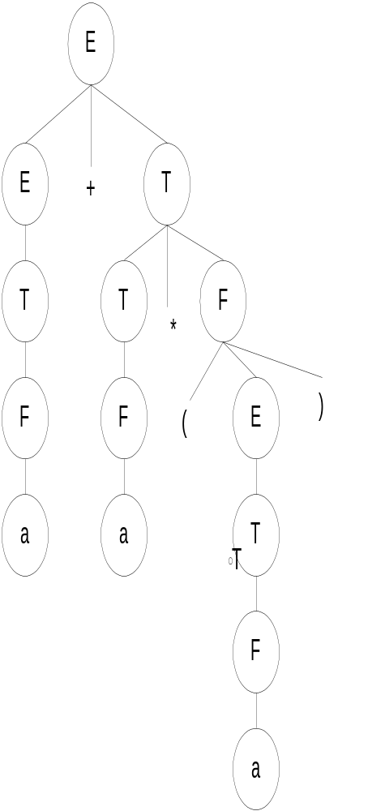
How Parsing might happen
Production Rules:
  E->E+T //E being the start symbol:
  E->T
  T->T*F
  T->F
  F->(E)
  F->a
Two TD parses of a+a*(a):
  Left-most derivation;
  Right-most derivation;
Bottom-up Parse (LD):
Notes:
<νυμβερ>
TD LD:
E-> E+T
E-> T
T-> F
F-> a
T-> T*F
T-> F
F-> a
F->(E)
E-> T
T-> F
F-> a
But the ones that did parse the instance resulted in the same structural result. (apart from the ordering annotation I put in) Therefore we can summarize the derivations by means of a parse tree (which leaves out the orderings). We can put in the production rules involved though.

Slide 24
Chomsky Parsing
Now parsing choices:
  Top-down / Bottom up - Strategy;
  Which Terminal/Non Terminal do we focus on - Sequence ;
  Which Production rule do we follow – Selection;
  Our initial choice: a (Top-down) LL(1) strategy
Notes:
<νυμβερ>
Can we move, using the production rules, from the start symbol to a pre-defined language instance;
Can we apply the production rules in reverse to work back up to the start symbol from the language instance:
If we establish at least 1 sequence of application of production rules…;
If we prove we cant establish a sequence of application of production rules…:
Looking to generate sentences, starting at the start symbol, going through sentential forms by applying production rules, until the sentential form contains no non-terminals and thus becomes a language instance.
Parsing: given a language instance (a string of terminal symbols), can we establish if the language instance is a structurally valid construct of that language.
Note, the 2 options on the slide suggest a top-down approach or a bottom-up approach.
Production rules in reverse means going from the rhs to the lhs and working our way back up to the start symbol
Illustrate the 2 options by means of the grammar over leaf
There can be several different parses (sequences of applications of production rules based on whether)
1: We consider it from the top-down or bottom-up perspective;
2: Even within these, it depends on the vocabulary element(s) we choose;
3: Again within these, it depends on which production rule we decide to apply when;

Slide 25
How might this happen
The need for automation!:
  You could write code to check your defined structure
  More ideally, you could use tools that gobble up your grammar and make the program that checks your defined structure
Lets:
  Check both alternatives out and
  Then see what happens ‘under the covers’
Notes:
So I think that here we need to diverge to the C version of a parser and the lex and yacc version of a parser
Then we look under the cover.
Lecture 7 addresses the C version
Lecture 10 addresses the lexx/yacc version
<νυμβερ>

Slide 26
Top-Down LD Parsing: Automation via the Predict set
Based On Grammar:
  E-> vT
  E-> P(E)
  P-> λ
  P-> f
  T->+E
  T->λ
Top-down, Leftmost Derivation of validity of f(v+v):
  First and follow set for each rule
  Look-ahead to see what comes next
  Starting at the start symbol, match them…
Notes:
<νυμβερ>
Top Down Parsing:
Starting at Parse Tree Root;
Corresponds to Leftmost Derivation;
Non Determinism / Backtracking:

Slide 27
Top-Down LD Parsing: Automation via the Predict set
Based On Grammar:
  E-> vT {v} //first sets
  E-> P(E) {f, (} //first sets
  P-> λ {(} //follow set
  P-> f {f} //first sets
  T->+E {+} //first sets
  T->λ {end-of input, )} //follow set
Top-down, Leftmost Derivation of validity of f(v+v):
  E -> P(E)
  P -> f
  E -> vT
  T -> +E
  E -> vT
  T -> lambda
(First and Follow set = Predict set)
Notes:
<νυμβερ>
Top Down Parsing:
Starting at Parse Tree Root;
Corresponds to Leftmost Derivation;
Non Determinism / Backtracking:

Slide 28
Top-Down Parsing: The Predict set
Based On Grammar:
  E-> vT
  E-> P(E)
  P-> λ
  P-> f
  T->+E
  T->λ
Leftmost Derivation v+f(v):
  E->P(E)
  ->f(E)
  ->f(vT)
  ->f(v+E)
  ->f(v+vT)
  ->f(v+v)
Notes:
<νυμβερ>
Top Down Parsing:
Starting at Parse Tree Root;
Corresponds to Leftmost Derivation;
Non Determinism / Backtracking:

Slide 29
Recursive Descent Code (Predictive Parsing):
A first simple example
TYPE -> SIMPLE
TYPE -> ^ id
TYPE -> array [ SIMPLE ] of TYPE
SIMPLE -> integer
SIMPLE -> char
SIMPLE -> num dotdot num
First Calculate the first/follow set for this grammar
Notes:
Where the dotdot = ..
<νυμβερ>

Slide 30
Recursive Descent Code (Predictive Parsing):
A first simple example
TYPE -> SIMPLE {integer, char, num}
TYPE -> ^ id {^}
TYPE -> array [ SIMPLE ] of TYPE {array}
SIMPLE -> integer {integer}
SIMPLE -> char {char}
SIMPLE -> num dotdot num {num}
Now work out if ‘array [ char] of char’ is a language instance, given TYPE as the start symbol
Notes:
Where the dotdot = ..
<νυμβερ>

Slide 31
And The Code…
In fact, codify-ing this turns out to be quite easy!
Our mode of operation for the code to do this:
  Have a procedure for every non terminal;
  If that terminal has more than one way to break it down then:
    In that procedure check the look-ahead for each (an ‘if’);
    For the production rule suggested by the look-ahead
      Match off any V_{T} encountered in that rule
      If V_{N} encountered in that rule, then call that V_{N} procedure before moving on;

Slide 32
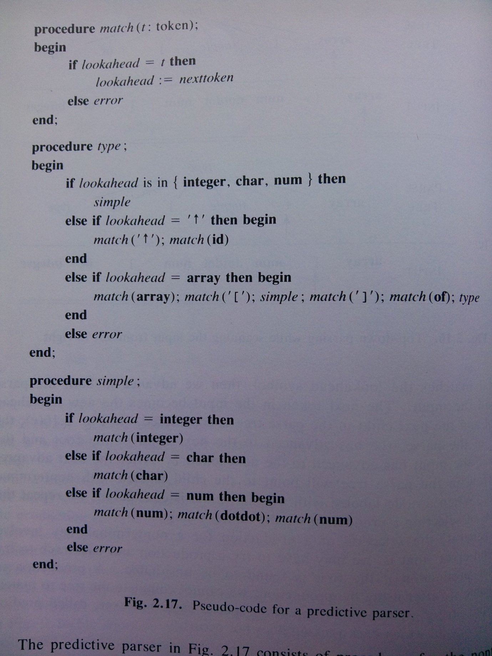
And here is the code
Walk-through “array [ 1..10 ] of char”
Notes:
See how stylized the code is: surely something automated could generate that…
<νυμβερ>

Slide 33
Do this for our first LD parsing example
  E-> vT {v}
  E-> P(E) {f, (}
  P-> λ {(}
  P-> f {f}
  T->+E {+}
  T->λ {end-of input, )}

